Slide 1
Mastering the Art of Play – Part 2:
Conducting and Facilitating Activities
Notes:
1 min
(0:00 – 0:01)
Say
Welcome, everyone! We’re excited to have you here today for part 2 of our training focused on mastering the art of play. For this portion of the training, we will focus on conducting and facilitating activities. Facilitators introduce themselves and what they love about C2L-PHL programming.

Slide 2
Training Goals
Create a Safe and Inclusive Environment
Understand Effective Facilitation Techniques
Learn how to Lead a Debrief Activity
Practice Facilitation
Notes:
1 min
(0:01 – 0:02)
Say
Over the next 90 minutes, we’re going to go deeper into what playful learning is all about. Participants will learn how to create a safe and inclusive environment, learn about effective facilitation techniques and finally, learn how to lead a debriefing activity.

Slide 3



Let’s Play!
Take a moment to quickly find everyday objects around you (toys, stationary or any small item that you can use creatively.)
This Photo by Unknown Author is licensed under CC BY-NC
Notes:
5 mins
(0:02 – 0:07)
Say
Before we get started, we welcome you to tap into your own imagination to think about play!
Read prompt then give instructions:
Take 3-4 minutes to engage in unguided play with the objects, interacting freely, in a pair or with a group (in-person).
If virtual, they can play on their own, creatively.
Facilitator share a few ideas on what kind of game and how they would play a game using a pen.

Slide 4
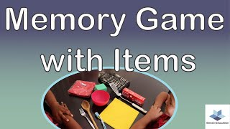
Notes:
5 mins
(0:07 – 0:12)
Say
Let's take a look at an example of using everyday objects to play creative games. This video is from Sense Education and gives a great example of using everyday objects for a memory game. Let's take a look and see what can learn from this.
Facilitator plays video then asks debrief question.
Do you think the game was effective in meeting the facilitator's objective? Why or why not?
Video link: https://youtu.be/q4S-yXRKtgI?si=88zQiMuYP_LHPCOU

Slide 5
What is Playful Learning?
Creativity
Social Skills
An approach where learning occurs through play where young children develop
Problem Solving
Emotional Development
Notes:
2 min
(0:12 – 0:14)
Say
Now let’s talk about playful learning and what it means. Playful learning is an approach where learning happens through play. It’s not just about having fun – though that is important – but also about helping kids develop social skills, creativity, and problem-solving abilities. For example, at any typical playground, we see playful learning in action all the time. Kids naturally engage in activities that challenge them physically and mentally – like figuring out how to navigate a tricky climbing structure or coming up with new games with friends. Again, this may be difficult for some to do on their own because of their past experiences. Our goal for part two of this series is to show you how you can conduct and facilitate this kind of learning at camp, making it both enjoyable and educational.

Slide 6
Safe and Inclusive Environments
Importance of creating a safe environment
  Physical safety
  Emotional safety
  Encouraging participation
  Managing group dynamics
  Addressing bullying
  Creating a positive, fun atmosphere
Notes:
1 min
(0:14 – 0:15)
Say
Now that we have reviewed what playful learning is, let's talk about how to make the environment safe and inclusive for youth and why. We will provide guidance on physical and emotional safety, how to encourage participation, how to manage the different dynamics of the groups you supervise, dealing with bullying and creating an overall positive and fun atmosphere.

Slide 7
Safe and Inclusive Environments
Tips for physical space setup
  Ensure clear, open spaces
  Create defined activity zones
  Provide easy access to materials
  Adjust for age and abilities
Notes:
1 min
(0:15 – 0:16)
Say
Also highly important is the physical setup of the learning space. By keeping the space clearly defined, organizing the materials or equipment and planning based on age and ability, your space can be setup for success. We will first go over the safety of the environment and then get into the tips.

Slide 8
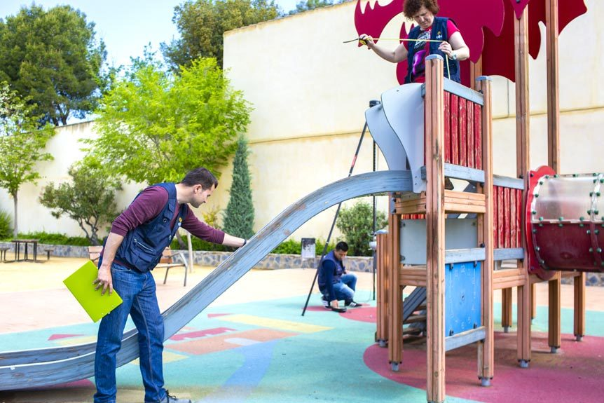
Importance Of Creating A Safe Environment
Physical Safety
  Ensure that the play environment is free from hazards (sharp objects, slippery areas, etc.) and that activities are age-appropriate
Emotional Safety
  Just as important as physical. Promotes feelings of acceptance and expression without fear of judgment or exclusion.
Notes:
2 mins
(0:16 – 0:18)
Say
Playful learning in a physically safe environment means ensuring that the environment can be used easily without the threat of injuries due to physical hazards that can cause slipping, falling or injuries to . The activities also need to be developmentally appropriate based on the age of the participants. To ensure this, be sure to check the play area for any potential areas before starting activities. Let's say you are about to start a group game activity. Prior to starting, do a walk-through of the play space to check for uneven ground, sharp objects or any item that could cause harm. So if you're playing tag near a wooded area, make sure there are no tree roots or rocks that the participants could trip over. What are some common hazards that you have noticed in your play areas?
Emotional safety is just as important as physical safety. need to feel emotionally secure, free from judgment or exclusion, so they can be expressive during play. For your group games, encourage all to cheer each other on, regardless of skill level to make it clear that everyone's effort is valued and it's not just about winning. Think of those relay races in gym class. When you organize one, praise teamwork and participation over who crosses the finish line first. When in your activities are shy or hesitant, how do you encourage them to participate?

Slide 9
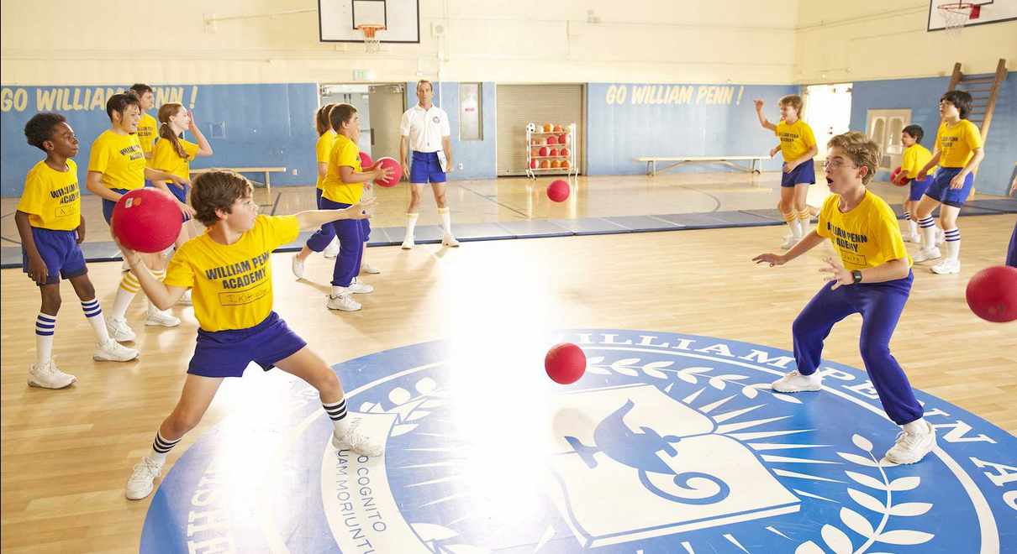
Importance Of Creating A Safe Environment
Encourage Participation and Inclusivity
  Everyone should have opportunities to participate fully regardless of ability, background or personality.
Manage Group Dynamics
  Just as important as physical. Promotes feelings of acceptance and expression without fear of judgment or exclusion.
Notes:
2 mins
(0:18 – 0:20)
Say
How can you modify activities to ensure all participants are able to join in? There are practical ways to do this. often want to be in a leadership role so offer these opportunities to them, adjusting the types of roles based on their ability levels. Picture a dodgeball game with participants that have mobility challenges. You can modify the rules so that those can be "protectors" who can block the ball for their team without having to run. This way, they are still fully engaged in the game. Think about what adaptations you can make to common games to ensure all participants can be engaged keeping the game fun while making sure it's accessible.
Managing the dynamics of the group involves monitoring the activities to ensure that none of the feels excluded or that no one or small group of s dominate the game. Everyone should be participating for it to be successful. Scavenger hunts can be lots of fun. To manage the dynamics during a scavenger hunt, assign rotating roles such as "leader," "clue solver," and "note-taker" to different participants. By doing this you can ensure that each has the opportunity to contribute in a way that matches their comfort level and strengths. What are some strategies you can use to make sure the quieter are involved and engaged? How would you handle a who tries to control the entire activity?

Slide 10
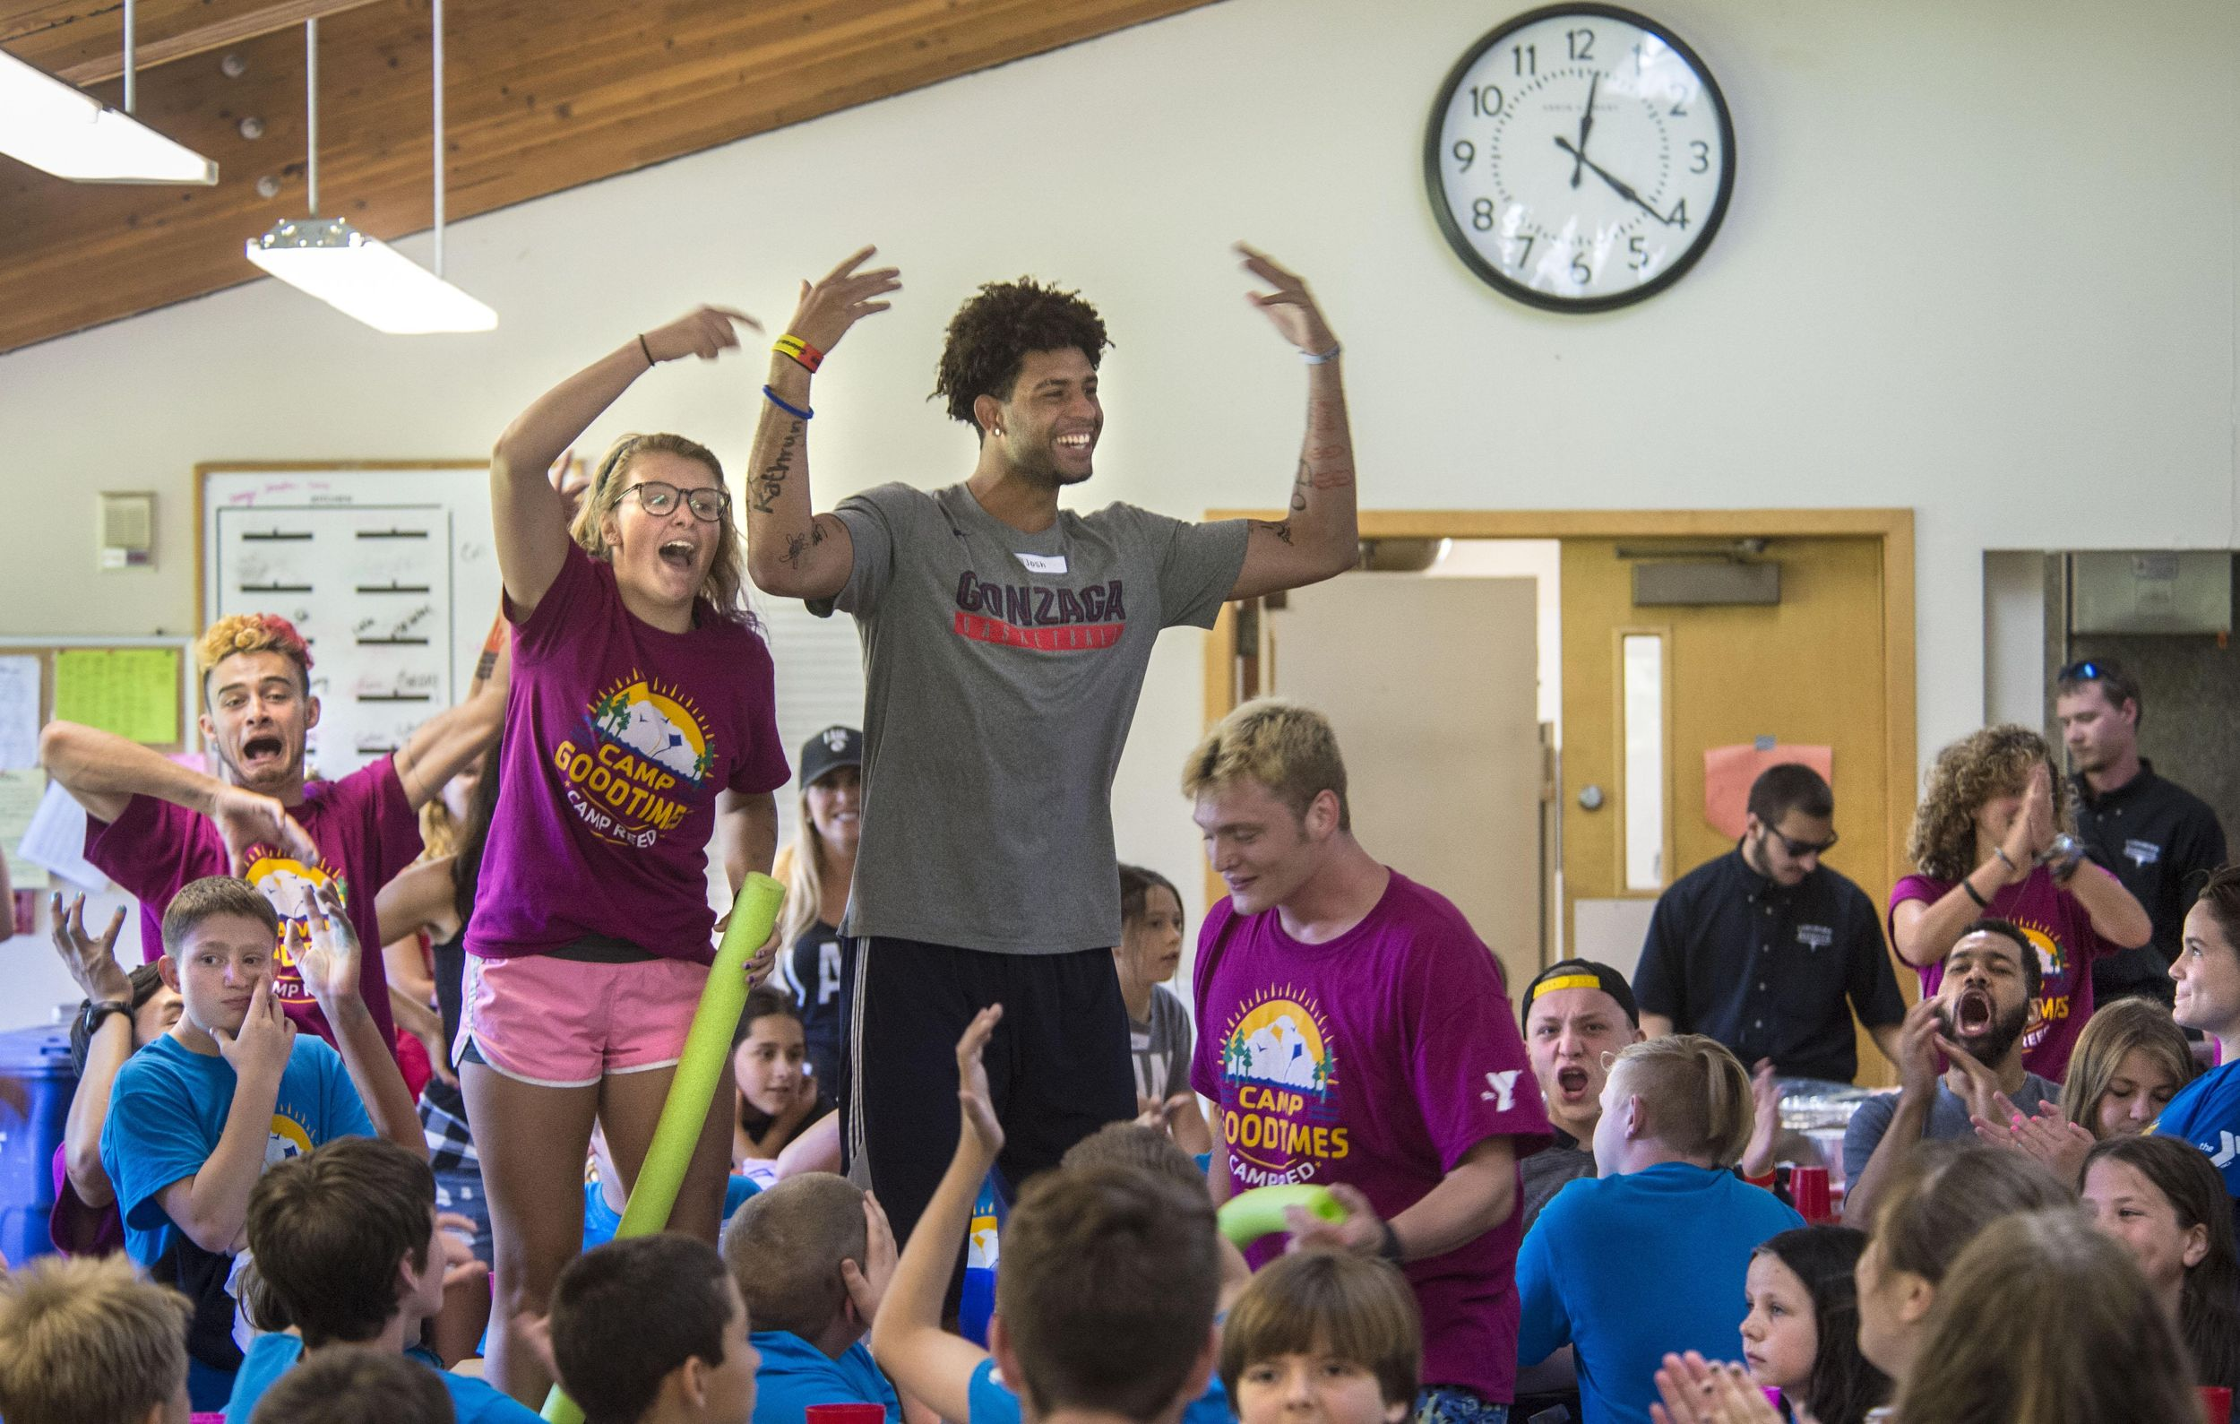
Importance of creating a safe environment
Addressing Bullying and Exclusion
  Bullying and exclusion are significant threats to a safe and inclusive environment, and they can happen even in playful settings.
Creating a Positive, Fun Atmosphere
  An inclusive environment is also a joyful one, where feel excited and energized to participate.
Notes:
2 mins
(0:20 – 0:22)
Say
We all know that bullying or exclusion can arise even in play so it is crucial to intervene quickly and effectively to maintain a safe, inclusive environment. Picture a summer camp environment where are being monitored by a counselor as they organize a game. Jaylin, one of your youth refuses to let another youth, Jeffrey, join the game. As a counselor, you should step in immediately and suggest ways to include everyone. You might say, "We need an extra player for the team, and Jeffrey would be great at it!" This reinforces the expectation or norm that no one is left out of games.
Emotional safety is just as important because need to feel accepted without judgment. How can you ensure that they feel safe? By establishing group norms emphasizing respect and kindness by fostering an environment where all ideas are valued. This can be done by creating rules about kindness and inclusion at the start of the program.
A playful, inclusive environment should be joyful, where feel encouraged to take risks, make mistakes and have fun without the pressure to win or succeed at everything. Picture a basketball free-throw shooting recreational game. Regardless of the number of free-throws made by the , celebrate their effort and experience of each participant by encouraging and cheering them saying things like "I love the effort!, "Nice try!" Or "well done!" Once it's over, be sure to pull everyone together and discuss the efforts by citing examples from the game such as "I see how you took your time, Alexis!" How can you help see that failure is a part of the learning process?

Slide 11
Pause & Reflect: Key Insights
Importance of Creating a Safe Environment
Jot down one key takeaway and share with a partner or small group.
Notes:
2 min
(0:22 – 0:24)
Say
Jot down one key takeaway and share with a partner or small group.
Debrief questions
“What is one insight or idea from this section that you will apply when working with youth?”

Slide 12
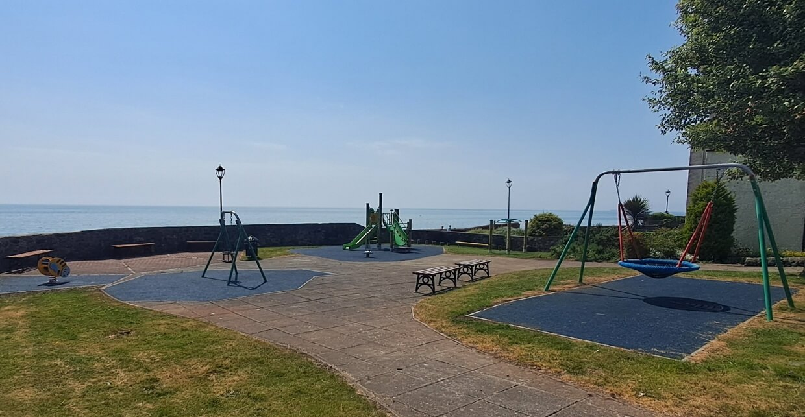
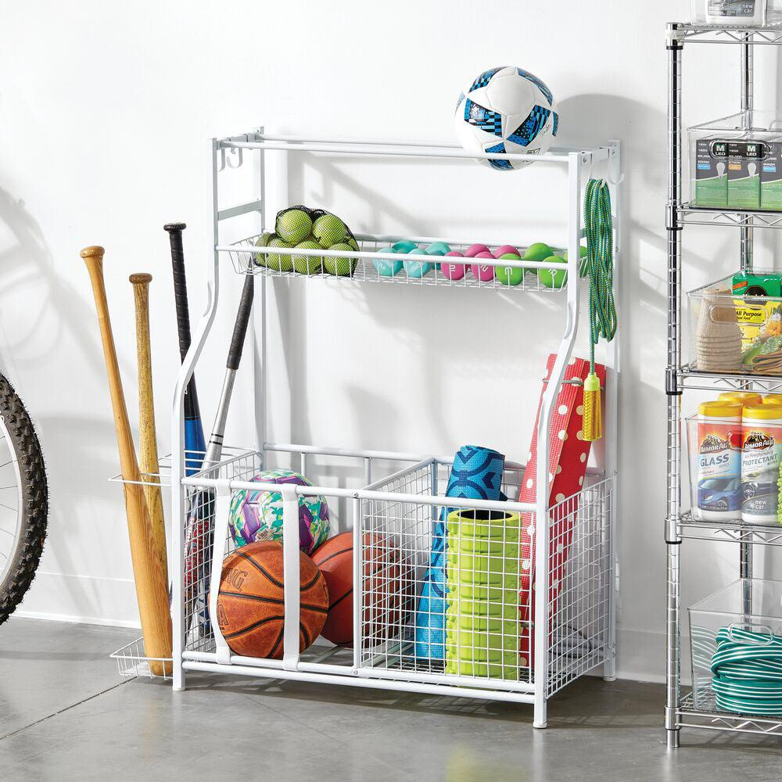
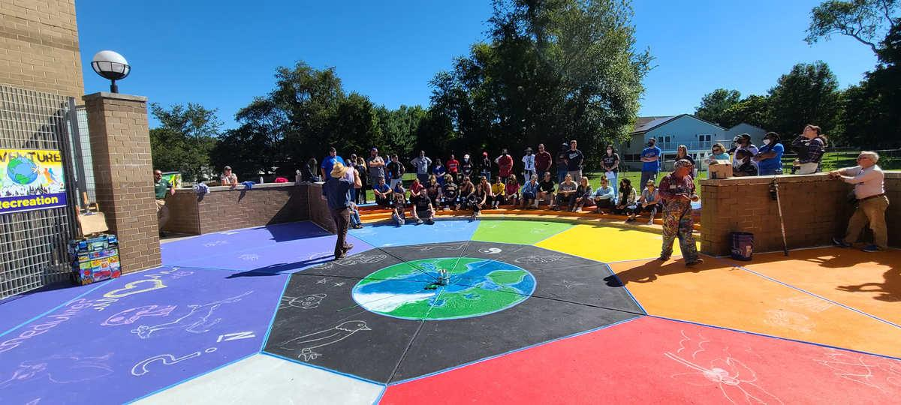
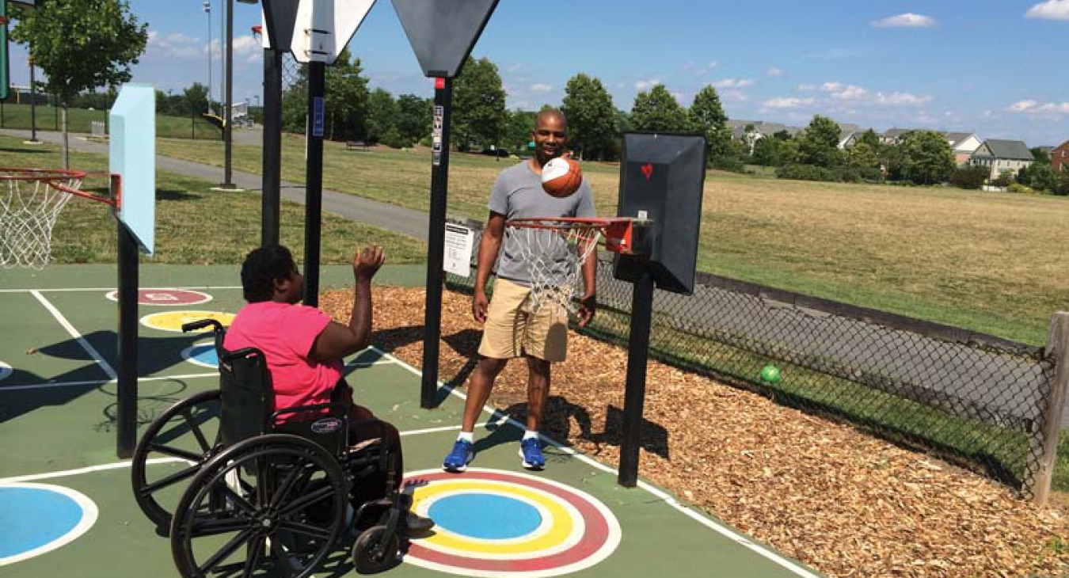
Tips for Physical Space Setup
Ensure clear, open spaces
Create defined activity zones
Provide easy access to materials
Adjust for different age groups or abilitities
Notes:
1 min
(0:24– 0:25)
Say
Next, let’s discuss the tips for setting up your physical space that will help you create a safe, organized and engaging environment. Over the next several slides, we’ll cover:
Ensuring clear open spaces
How to create defined activity zones
Ways to provide easy access to materials and
How to adjust your playful learning by age group and ability

Slide 13
Tips for Physical Space Setup
Ensure clear, open spaces
Notes:
1 min
(0:25 – 0:26)
Say
Let’s start with the setup of your safe learning spaces. Begin by thoroughly sweeping the area to remove any hazards like rocks, sticks, or other debris that could cause injury. Also, check for unsafe surfaces, such as slippery or uneven ground, and remove any unnecessary items like backpacks or chairs. These actions prevent accidents and ensure a safe play environment.

Slide 14
Tips for Physical Space Setup
Ensure clear, open spaces
Create defined activity zones
Notes:
2 min
(0:26 – 0:28)
Say
Defining separate areas for different types of play helps avoid confusion and keeps youth focused. Specific zones for physical games, quiet activities, or group discussions make transitions smoother and reduce the likelihood of chaos. You can easily achieve this with visual markers like colored cones or floor tape to clearly define each zone.
For instance, designate a ‘quiet play area’ for calmer activities such as board games or puzzles, while reserving a ‘physical activity zone’ for sports and movement-based activities. By clearly marking these areas, participants can understand the expectations for each space.
This approach keeps the atmosphere organized and allows you to manage the flow of energy effectively. For example, transitioning from a high-energy activity to a calmer one becomes more seamless when zones are predefined.
As you plan activities, consider your space layout and resources. Think about where each activity will take place and how to visually communicate that to the youth. When they arrive at the activity zone, they will already know what to expect, ensuring a smoother and more engaging experience."

Slide 15
Tips for Physical Space Setup
Ensure clear, open spaces
Create defined activity zones
Provide easy access to materials
Notes:
2 min
(0:28 – 0:30)
Say
Now, let’s talk about organizing materials and ensuring all youth can fully participate in your activities. It’s essential to have all materials—like balls, ropes, or craft supplies—arranged in clearly labeled bins or storage racks near the activity space. This way, youth can access what they need without disrupting the flow of play. Having everything ready to go keeps the momentum and engagement high, avoiding delays that could lead to losing the youths' attention.
You’ll also want to ensure that youth of all abilities can participate. Some may need the games to be adapted to suit their skill levels or physical abilities. For younger youth, simplifying the rules or shortening the duration works well. For those with cognitive or physical disabilities, adjust the game speed or provide adaptive equipment to ensure full inclusion.

Slide 16
Tips for Physical Space Setup
Ensure clear, open spaces
Create defined activity zones
Provide easy access to materials
Adjust for different age groups or abilities
Notes:
2 min
(0:30– 0:32)
Say
When you're running activities, it’s super important to make sure everyone can join in—no matter their age, ability, or experience level. The key to being a great counselor is knowing how to adjust things on the fly to keep it fun and challenging for everyone. That might mean tweaking the rules or making the game easier for some youth so they can still feel like they're part of the action.
For example, let’s say you’re playing a classic game like tag, but you have younger participants in the mix. You could shrink the boundaries or keep the rules simple, like giving them more time to 'freeze' or tag someone. Or if you’re doing something like a relay race, and you notice the younger ones are struggling, you could shorten their distance or reduce the number of steps they have to complete. It’s all about keeping the energy high but still making sure everyone feels comfortable.
Now, if you’re working with youths who have cognitive or physical disabilities, you might need to switch things up a bit. Say you're playing soccer, and one of your youth has limited mobility. Instead of excluding them, why not use a bigger, lighter ball or slow down the pace of the game? You could even have them stay in one spot, like as a goalie, so they’re still part of the action without having to run all over the place.
If a youth has trouble with complex instructions, break it down for them. Instead of throwing all the rules at them at once, give them one thing to focus on. For example, in a scavenger hunt, instead of saying ‘find five things,’ just tell them the first thing to find and work from there. Keep it simple and clear.

Slide 17
Pause & Reflect: Key Insights
Tips for Physical Space Setup
Jot down one key takeaway and share with a partner or small group.
Notes:
3 min
(0:32 – 0:35)
Say
Jot down one key takeaway and share with a partner or small group.
Debrief questions
“What is one insight or idea from this section that you will apply when working with youth?”

Slide 18
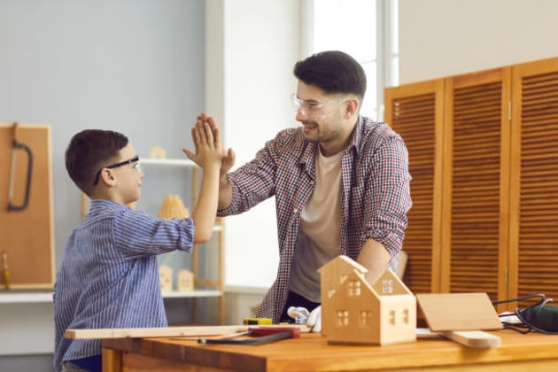
Facilitation Techniques
Encouragement and positive reinforcement
Notes:
2 min
(0:35 – 0:37)
Say
Now that we've talked about how to set up the physical space to create a great environment for learning through play, let’s dive into how you can facilitate those activities in a way that keeps youth engaged and helps them grow. As a reminder, one of the most important things to keep in mind is the developmental age of the youth you're working with. You want to involve them and make sure they stay engaged throughout the activity.
Encouragement and positive reinforcement go a long way here. Your energy sets the tone. If you’re excited and positive, your youth will feel that too. Simple things like complimenting a youth when they’re mastering a new skill or showing good teamwork can build their confidence. For example, if you see someone who normally sits out finally joining a game, point it out: ‘I love how you jumped in and helped your team just now! That was awesome teamwork.’ Don’t just praise the end result—highlight their effort and progress, even if they don’t win the game. This helps them focus on improvement and keeps them motivated.

Slide 19

Facilitation Techniques
Active listening and responding to participant needs
Notes:
1 min
(0:37 – 0:38)
Say
Another powerful tool is active listening. Really pay attention to what your participants are saying, not just with words but also through their body language. If you notice a youth looking upset or quiet, take a moment to check in. Something as simple as, ‘Hey, I noticed you seem a bit quiet today. Want to talk about it?’ can show them that you care. This helps build trust and makes them feel valued. Sometimes, just knowing someone is listening can turn their day around. It also gives you a chance to adjust activities to fit their needs if something's off.

Slide 20
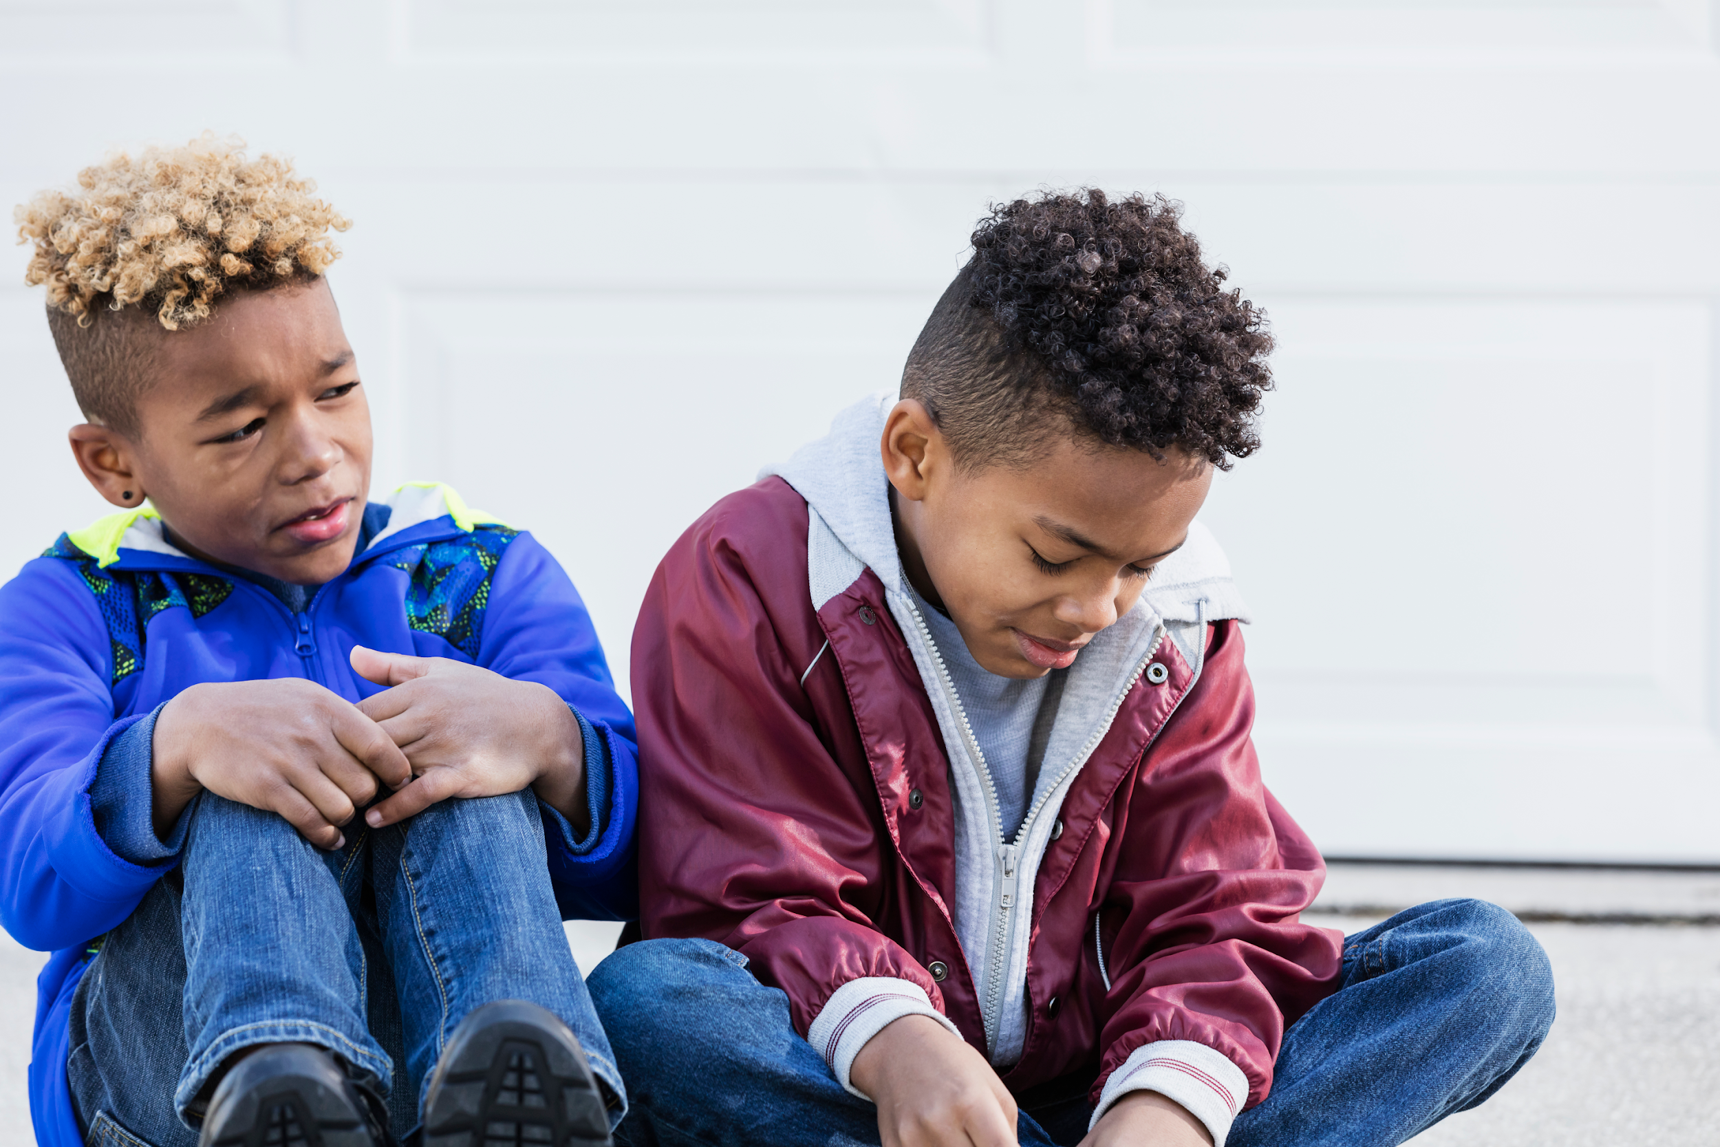
Facilitation Techniques
Dealing with challenges (disengagement, conflict)
Notes:
1 min
(0:38 – 0:39)
Say
Handling conflicts is also a big part of facilitation as a camp counselor. If you notice two participants arguing over a game, it’s important not to ignore it. Step in calmly and help them work through it. You could say, ‘I can see you're both frustrated. Let’s talk about what’s going on.’ Let them express how they’re feeling, then help guide them to a solution, like taking turns or creating a new rule that works for both. Stay calm, stay neutral, and keep the situation under control. This way, you’re helping them learn important life skills like communication and problem-solving while keeping the vibe positive for everyone.

Slide 21
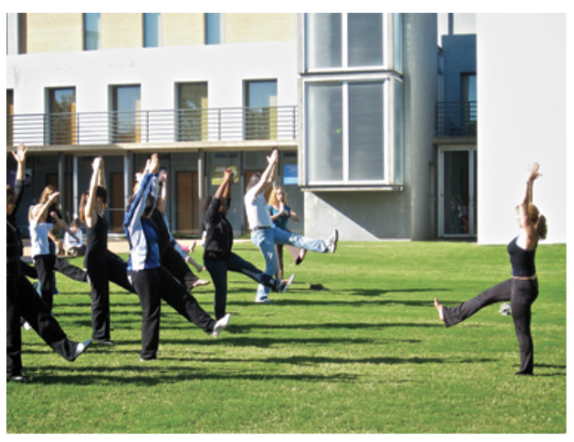
Facilitation Techniques
Modeling Behavior
Set the example for participants by demonstrating positive actions
Engage in activities and follow the same rules as the participants
Model teamwork, respect, and active participation
Notes:
1 min
(0:39 – 0:40)
Say
As camp counselors, your actions speak louder than words. participants look to you as a role model. Whether it’s fully participating in an activity, following rules, or simply showing respect to others, your behavior sets the tone. If they see you fully engaged, they’ll likely follow your lead. Make sure to demonstrate teamwork, kindness, and active participation, because it encourages them to do the same. When they see you enjoying and embracing the activity, it motivates them to jump in too.

Slide 22
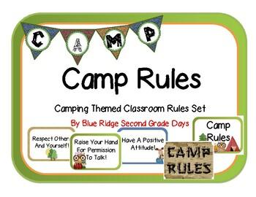
Facilitation Techniques
Provide clear and simple instructions before every activity
Clear Instructions and Expectation
Explain the rules and objectives to avoid confusion
Ask questions to confirm understanding
Notes:
1 min
(0:40 – 0:41)
Say
It’s really important to make sure everyone understands the activity before it begins. This means providing clear, step-by-step instructions that are easy to follow. If the instructions are complicated, youth might feel confused or overwhelmed, so keep it simple. Always explain the rules and the goal of the activity, and ask if anyone has questions before starting. If you feel it’s necessary, model the behavior for the activity as noted in the previous slide.

Slide 23
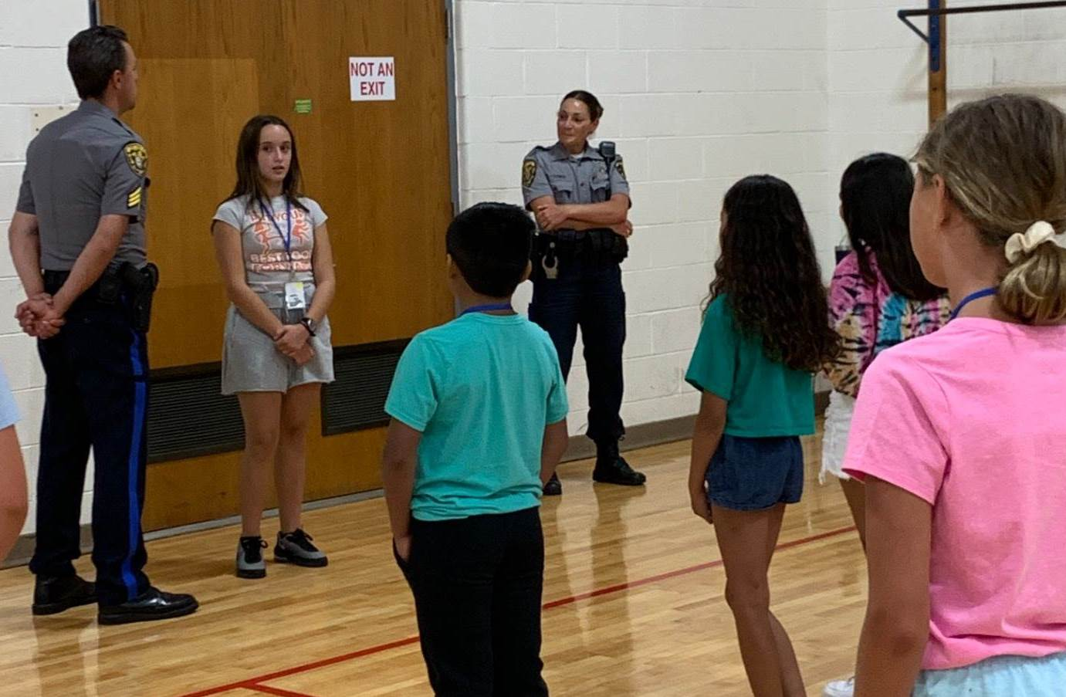
Facilitation Techniques
Give youth leadership roles
Peer Leadership
Rotate roles so everyone can lead
Notes:
1 min
(0:41 – 0:42)
Say
A great way to build confidence in youth is by giving them leadership roles. Whether it’s leading a game, facilitating a group discussion, or being the team captain, rotating these roles helps develop their leadership skills. It’s also a great way to engage those who may be shy or less involved. Let youth take responsibility for certain parts of the activity—it builds confidence, teamwork, and a sense of ownership. Plus, it helps them build relationships with their peers.

Slide 24

Facilitation Techniques
Use non-verbal cues like gestures and eyes contact
Using Non-verbal Cues
Thumbs up for encouragement or approval
Smile or nod to reinforce positive behavior without words
Notes:
1 min
(0:42 – 0:43)
Say
Nonverbal cues are a subtle but powerful way to manage youth and keep them engaged. Simple gestures like a thumbs-up can encourage and show approval, while raising your hand can signal that it’s time to quiet down or pay attention. Making eye contact with a youth who seems distracted can bring them back into the activity without interrupting the flow. A smile or nod can be just as effective as verbal praise, especially when you're trying to keep the energy light and positive.

Slide 25
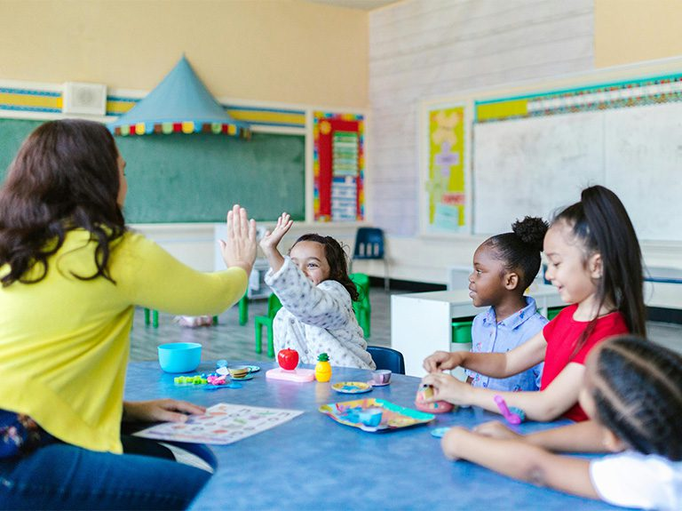
Facilitation Techniques
Use friendly competition to make games fun
Gamification: Make Learning Fun
Create point systems or team challenges for completing activities
Notes:
1 min
(0:43 – 0:44)
Say
Gamification uses game-like elements to make non-game activities more engaging and fun. In your program, this can include adding points, badges, and challenges to boost youth participation on the boards, screens or as handout trinkets.
Why use gamification? It increases engagement by making tasks feel like games, motivates participants with rewards, and encourages social
interaction. For example, a simple leaderboard or point system can motivate participants to complete tasks or cooperate with each other, which can foster
teamwork.
Here are some key elements to include when making learning fun through gamification:
Points or badges for achievements,
Leaderboards for friendly competition,
Structured challenges that get progressively harder, and
Rewards for collaboration and effort.

Slide 26
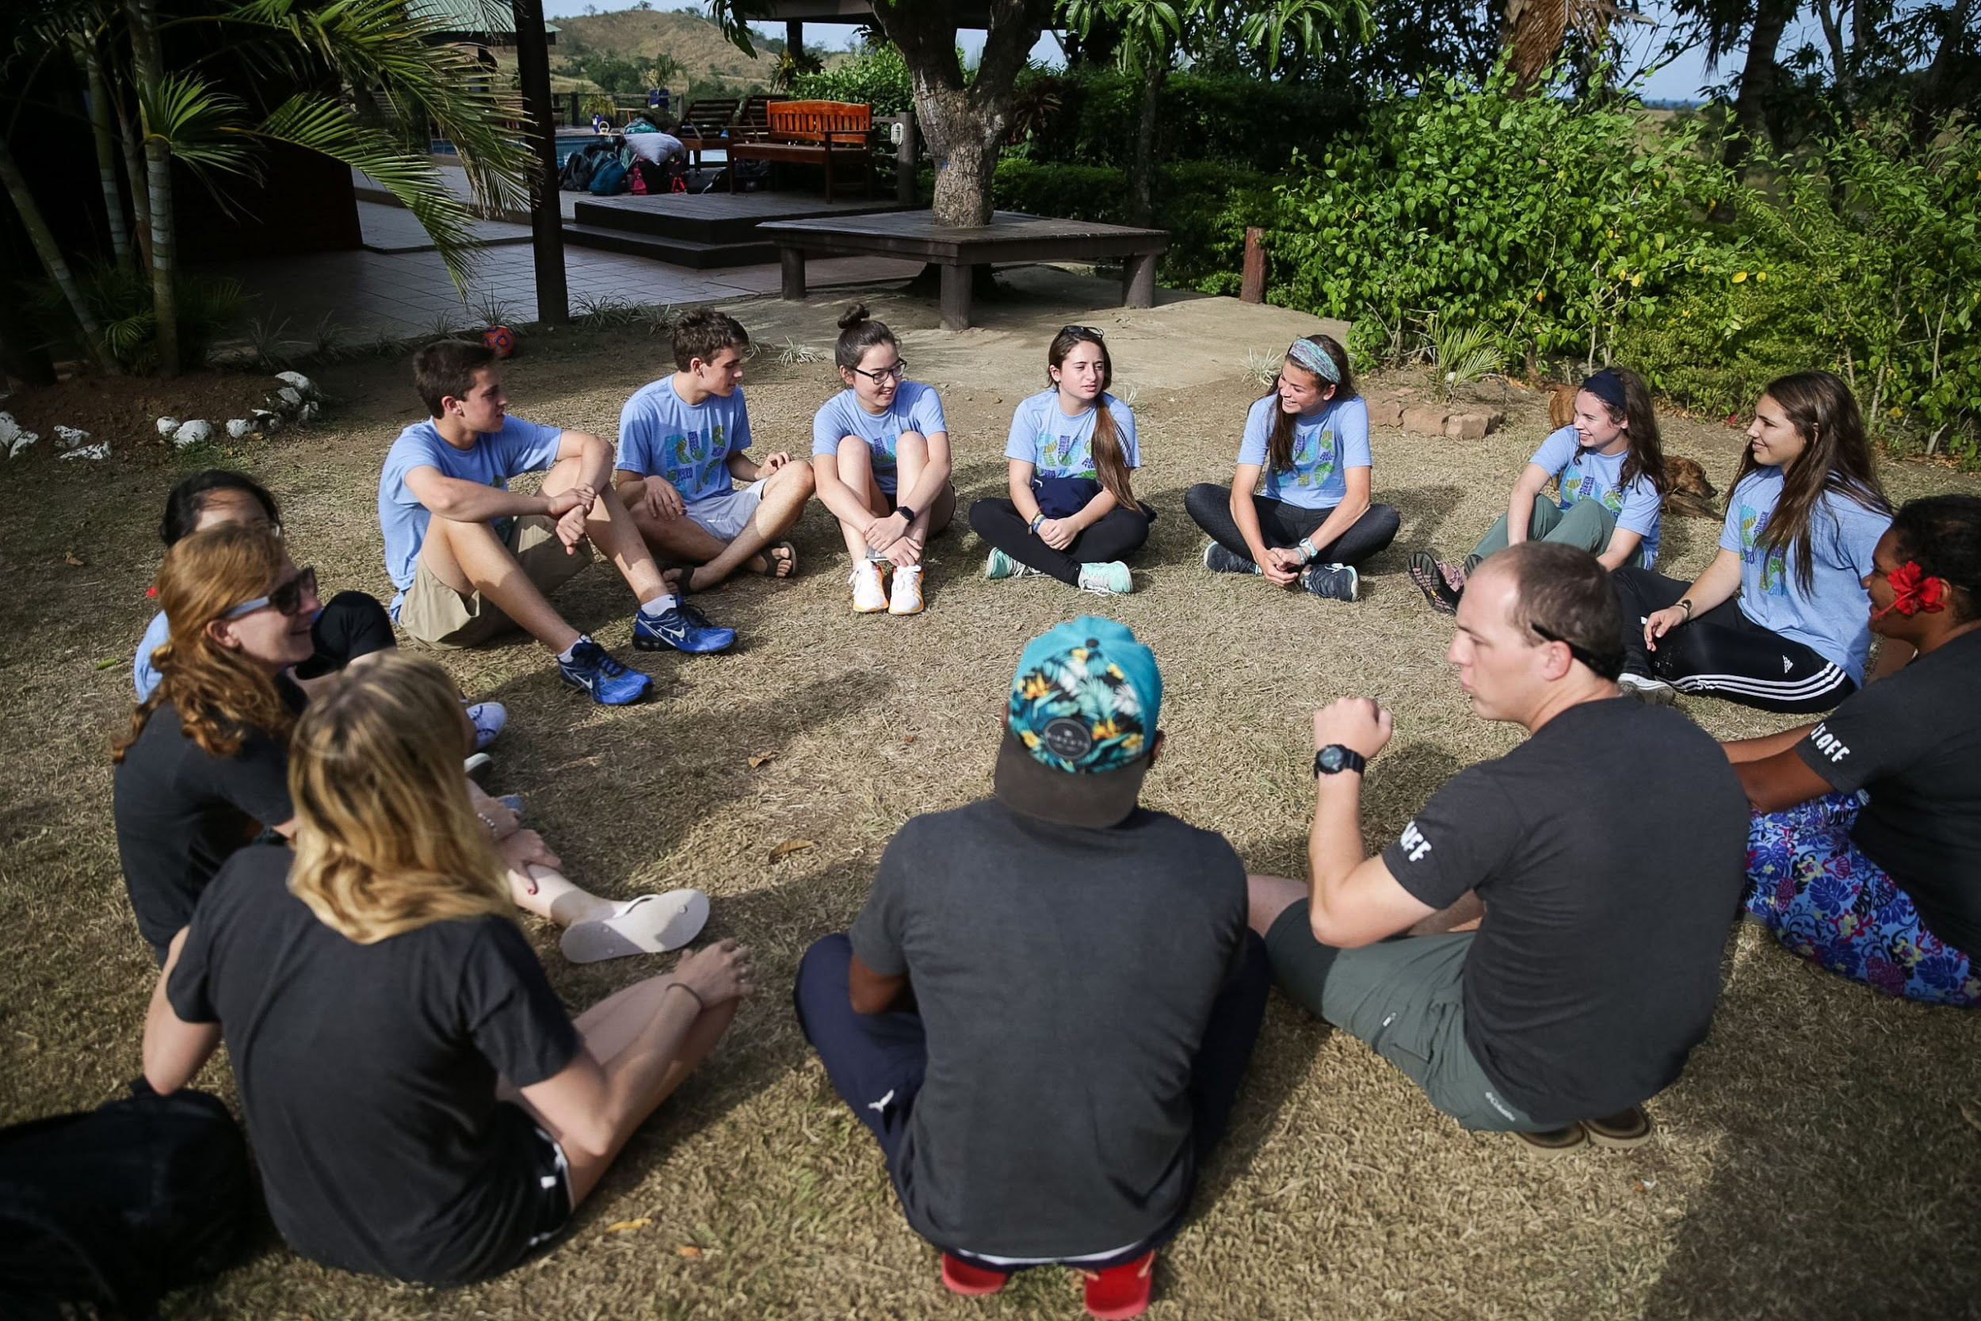
Facilitation Techniques
Storytelling
Notes:
3 min
(0:44 – 0:47)
Say
Another effective and powerful facilitation technique is storytelling, which brings abstract ideas to life through real-world examples. Storytelling creates a personal connection between the counselor and the youth, making learning feel more relevant and memorable. As camp counselors, you have the opportunity to use your own experiences or those of your youth to illustrate the importance of playful learning.
For example:
Use a personal story to reflect on a specific time you saw a youth learn through play. This could be something as simple as a youth discovering how to work as a team during a group game or finding their confidence through a playful activity. You may say something like, “I remember a time when a shy youth, who rarely participated in group activities, was finally drawn out of their shell during a game of cooperative tag. Through play, they realized they could lead the group to victory by using their observation skills rather than speed. That moment of connection helped build their self-esteem, which carried over to other activities for the rest of camp.”

Slide 27
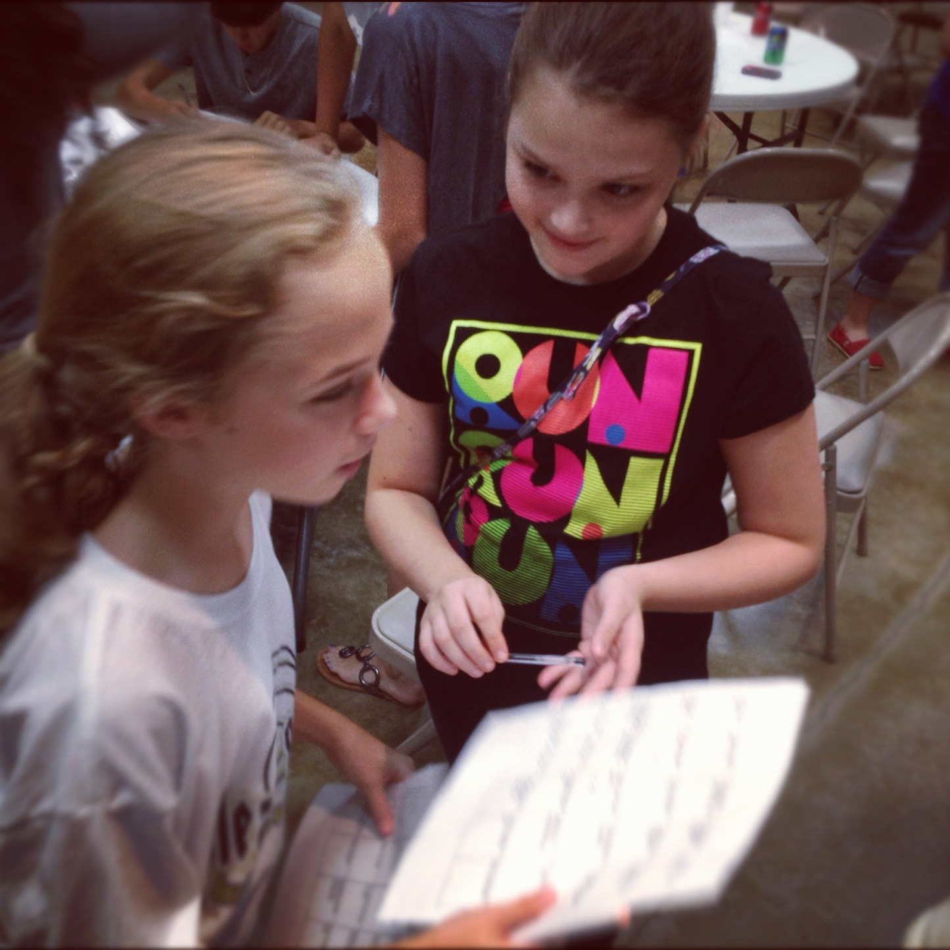
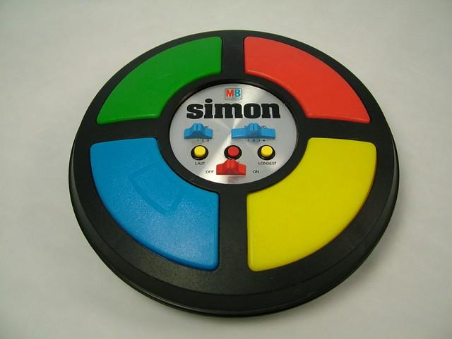
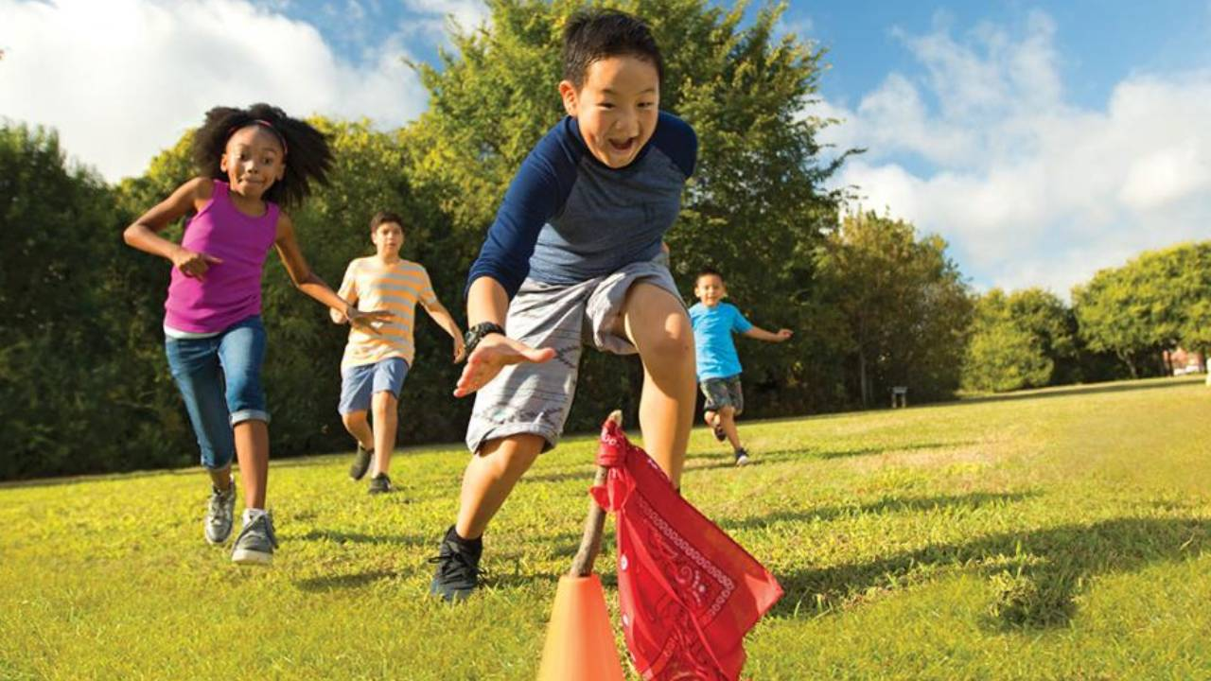
Facilitation Techniques
Tailoring for Specific Age Groups
Notes:
3 min
(0:47 – 0:50)
Say
When facilitating activities for youth of different ages, it’s important to remember that not all play is created equal. What works for a group of 6-year-olds will likely not engage a group older . Tailoring activities to the developmental stages and interests of different age groups ensures that all youth are challenged, engaged, and learning through play. Younger participants, particularly those between 6-8 years old, often need more structured play to feel comfortable. They are still learning the basics of social interaction and often benefit from activities that focus on taking turns, sharing, and cooperation.
For this age group, games that are simple, interactive, and imaginative tend to work best.
Think about a game like Simon Says, it’s structured, easy to follow, and helps younger youths practice listening and responding to instructions while having fun. But for older youths, this game might feel too simplistic or juvenile.
As youth get older (ages 10-14), they typically enjoy more complex, competitive, or strategy-based games. These games can allow them to test their critical thinking and problem-solving skills. Older youth also tend to appreciate activities that let them take on leadership roles or create their own rules, giving them a sense of agency and independence. You could introduce a game like Capture the Flag, where they not only need to use physical skills but also work as a team to come up with a strategy. This taps into their need for competition and teamwork, while still being a fun and active game.”
In cases where you have a mixed group of youth, the challenge is finding ways to balance the skill levels without alienating any age group. If you’re leading a scavenger hunt, younger participants can search for clues, while older participants can take on the role of team leaders or clue creators. This way, everyone is engaged at their own level, but they’re still working together toward a common goal.

Slide 28
Pause & Reflect: Key Insights
Facilitation Techniques
Jot down one key takeaway and share with a partner or small group.
Notes:
3 min
(0:50 – 0:53)
Say
Jot down one key takeaway and share with a partner or small group.
Debrief questions
“What is one insight or idea from this section that you will apply when working with youth?”

Slide 29
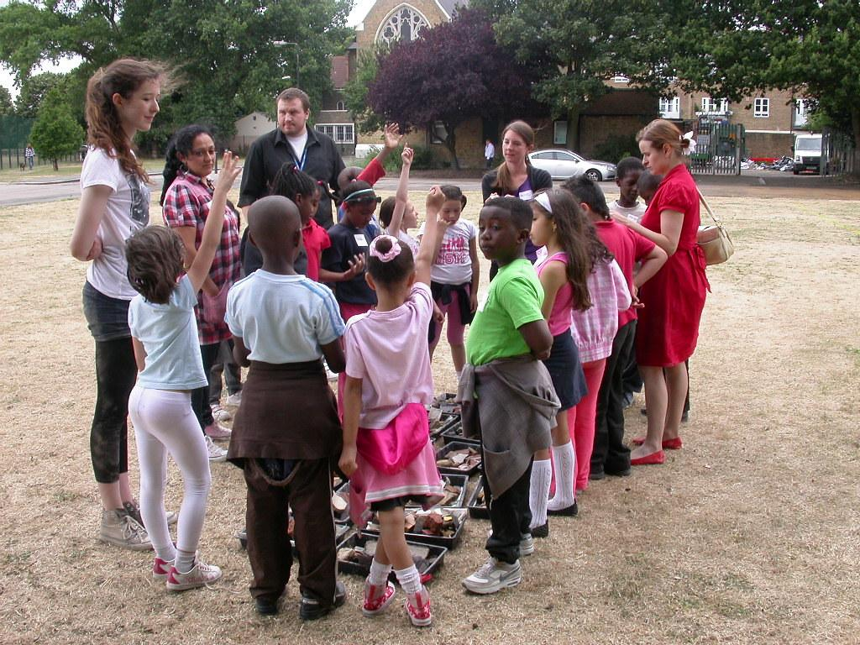
Debriefing Activities
What is debriefing?
A time to reflect on the activity, share thoughts and discuss improvements
Helps youth process their experiences and share with each other
Notes:
2 min
(0:53-0:55)
Say
Now that we’ve covered setting up activities, let’s move on to debriefing. Debriefing is the time after an activity where you reflect on what happened, discuss what went well, and talk about what could be improved. It’s an important step to help youth process their experiences, learn from them, and build stronger connections with each other. For example, after a group game, you might ask the youth, “What did you enjoy most about the game? What was challenging?” This gets them thinking about their participation and helps them share feedback.
Another example is using a “Rose, Thorn, and Bud” approach. Ask each youth to share one positive thing (rose), one challenge (thorn), and one thing they’re looking forward to (bud). This activity is simple, fun, and helps build group communication while encouraging reflection.

Slide 30
How to Lead a Debrief
1. Create a relaxed, open environment
2. Ask open-ended questions to encourage discussion
3. Encourage feedback
4. Use activities to facilitate discussion
5. Summarize key takeaways
Notes:
2 min​
(0:55 – 0:57)​
​
Say​
Start by creating a relaxed, open environment. Let participants know that debriefing is a judgment-free space where everyone is encouraged to share their
thoughts. While participation is encouraged, remind them that it’s okay to just listen if they don’t feel comfortable talking.
Ask open-ended questions to spark meaningful conversation. For example, ask questions like, “What did you learn?” or “How did it feel to work as a team?”
These types of questions lead to deeper reflection and more thoughtful responses. Avoid simple yes/no questions, as they limit discussion.
Observe and provide feedback based on what you noticed during the activity. Tailor your questions to specific moments or participants who may need
encouragement to share their experiences. Aim to get feedback from all participants by being consistent in encouraging it and using creative methods to make
participation fun and engaging.
Incorporate activities to help youth express their thoughts. These activities can open up richer discussions about their experiences and foster a stronger
connection to the debriefing process. Summarize key takeaways at the end of the debriefing to reinforce the learning objectives. While the activity may have
been playful, remind youth that there was a deeper purpose. Identify the main lessons from the activity and use this as a natural transition to the next
activity.

Slide 31
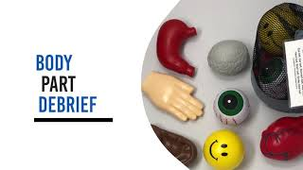
How to Lead a Debrief: Short clip
Notes:
5 min​
(0:57 – 1:02)​
Say
Now that we've covered the key points of leading a successful debriefing session, let's explore a fun and interactive debriefing technique called the 'Body Part Debrief. In this video, you’ll see how playful props, like toy body parts, are used to facilitate an engaging conversation where participants reflect on what they learned, how they felt, and how they worked as a team. Pay attention to how each youth connects the prop to their experience, and how the facilitator encourages them to express their thoughts creatively.
Debrief questions to ask:
What did you hear about how they felt?
How did the facilitator connect the props to the experience?
What did the facilitator do to encourage the participants?
Video: The Body Part Debrief

Slide 32

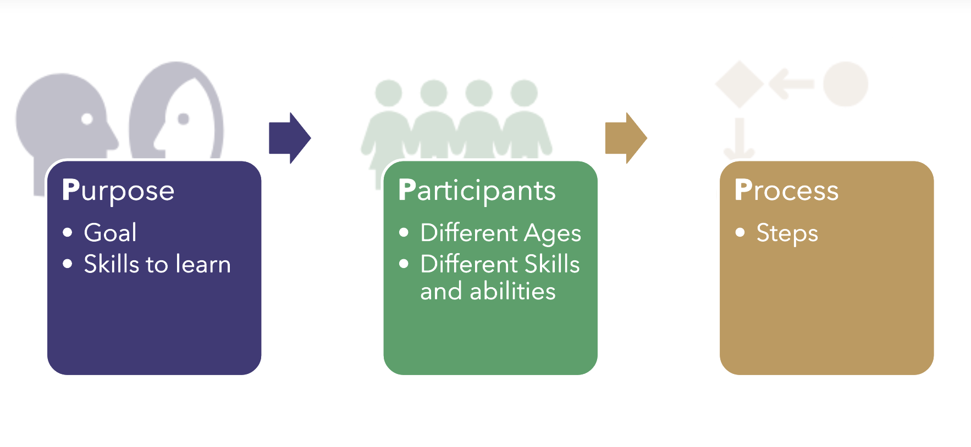
The 3 Ps
Remember
Notes:
2 mins
(1:02– 1:04)
Say
In Part 1 of Mastering the Art of Play, we learned about the concept of intentionality when it comes to planning playful activities for younger . We talked about how being intentional means planning and facilitating activities with a clear purpose in mind.
The goal is to ensure that participants are learning while they play.
We also covered the 3 Ps of Playful Learning:
1. Purpose – What is the goal of the activity?
2. Participants – Consider who’s involved. You might have kids of varying ages and skill levels.
3. Process – How will the activity unfold? What are the steps involved?
Now that we’ve revisited the 3 Ps, it’s time to apply them. In the next activity, you will watch a video clip and use what you’ve learned about the 3 Ps to practice creating intentional, playful learning experiences. This is your opportunity to take what you remember and put it into action. Let’s dive in!

Slide 33
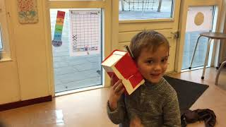
Practice Debriefing Activity
Notes:
7 min
(1:04 – 1:11)
Say
Take a look at this video and pay attention to note if the 3P's are evident in the activity. Play video and ask participants were the 3ps evident.
How would you debrief this activity?
If counselors do not or are not able to give an answer prompt with these prompts:
"When watching the video, did you notice any participants who seemed to dominate the activity or any who were less involved? How might you ensure full participation in an activity like this."
"In this activity, what do you think the participants learned by the end? How would you define the purpose of this activity if you were facilitating it?"
"What steps or process did you observe in the video that helped guide the participants? Can you think of ways to adjust the process for different skill levels or group sizes?“
Debrief
Ask participants:
Were the 3 P’s evident in this activity?
How would you debrief this activity?
Video: Play based learning in Early Years

Slide 34
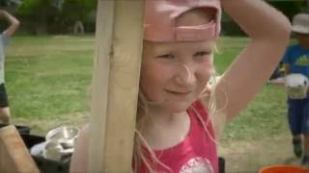
Practice Debriefing Activity
Notes:
5 min
(1:11 – 1:16)
Say
Take a look at this second video and pay attention to note if the 3P's are evident in the activity. Play video and ask participants were the 3ps evident.
How would you debrief this activity?
Video link: Outdoor Play and Learning: Loose Parts

Slide 35
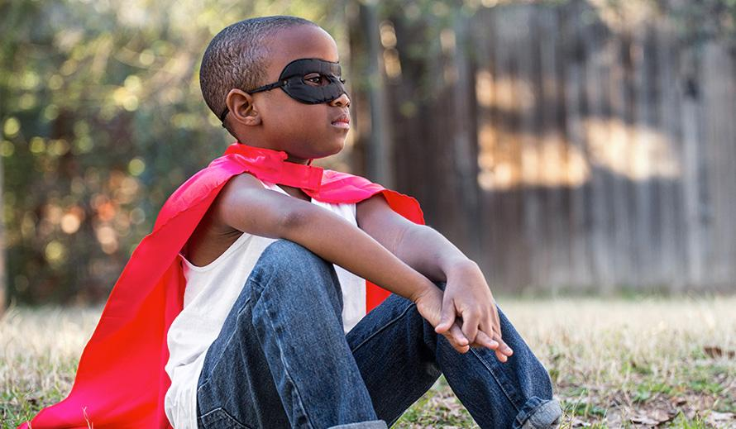
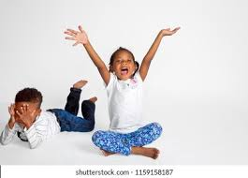
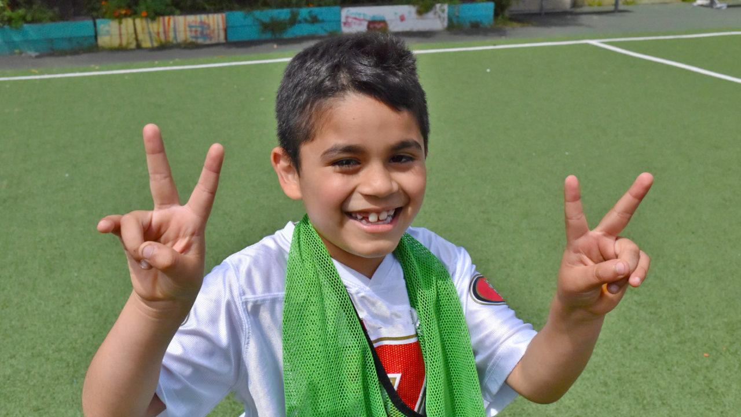
Managing youth Personalities
Introverted
Personality types of youth
Extroverted
Natural Leaders
Notes:
3 min
(1:16 – 1:19)
One of the most important aspects of facilitating activities for youth is recognizing that each youth has their own unique personality. Understanding and managing different youth personalities ensures that every child feels included, valued, and able to participate fully in the group. This involves being flexible and adapting activities to cater to the diverse needs of introverts, extroverts, leaders, followers, and everyone in between.
Introverted youth often prefer smaller, quieter settings and may be hesitant to jump into large group activities. They might struggle with competitive or high-energy games and may need more encouragement to engage with the group.
If you notice that a youth is hanging back during an activity, consider offering them a role that lets them participate at their comfort level, such as being the scorekeeper or team strategist. This way, they can still contribute without feeling overwhelmed.
Give introverted youth time to warm up by starting with low-pressure, small group activities before moving into more dynamic group settings.
Extroverted youth often thrive in high-energy environments and are quick to take on leadership roles. While this enthusiasm is great, it’s also important to ensure that they don’t overshadow quieter youth or dominate group activities.
For a very outgoing youth who loves to lead, you can channel their energy productively by assigning them specific leadership tasks, such as facilitating a game or helping to organize the group. This allows them to take initiative while ensuring they are including others.
Be mindful of group dynamics—encourage extroverted youth to step back at times and give others a chance to shine.
Some youth naturally step into leadership roles, whether through extroversion, confidence, or experience. While it’s great to foster leadership, it’s important to guide these youth in leading with kindness and inclusion, rather than control. If a youth is taking charge of an activity, make sure they are setting an example by encouraging teamwork and fair play. For example, if they’re leading a relay race, remind them to focus on supporting their teammates and ensuring everyone gets a turn.”
Managing different personalities within a group requires a balance. You want to make sure that everyone has a chance to participate, no one feels left out, and the more dominant personalities don’t take over. This means being an active observer during activities and adjusting as needed. If you notice one youth talking over others, gently step in and say, ‘Let’s make sure everyone gets a chance to share their ideas.’ This reinforces the value of inclusion and fairness in group activities.
Rotate roles within activities so that all youth, regardless of their personalities, get opportunities to lead, participate, and support their peers.

Slide 36
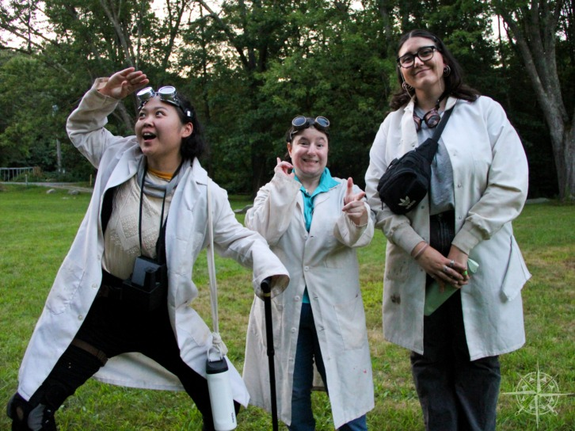
Facilitator Role Play & Reflection
Let’s practice facilitating!
Notes:
15 min
(1:19 – 1:34)
Say
Now that you have learned about creating a safe and inclusive environment, understanding effective facilitation techniques and how to lead a debrief activity let’s practice some role facilitation.
Instructions::
Setup: Provide each counselor (or "youth") with a piece of paper and a pencil. Assign one person in each group to be the facilitator, while the others play different personality roles (introverted youth, overly enthusiastic youth, etc.).
Read the task aloud for the group:
Say
The group must work together to create a drawing or visual representation of what teamwork looks like to them.
The drawing can be literal (people working together) or abstract (symbols or objects that represent teamwork, like hands coming together or gears interlocking).
Each "youth" contributes to the drawing one piece at a time, adding their ideas of what teamwork looks like.
The facilitator's job is to manage the personalities and make sure everyone contributes.
The facilitator should prompt the group based on each person's personality role:
For example, for the:
Introverted youth: “You have great ideas—what small part would you like to add to show teamwork?”
Overly Enthusiastic youth: “Let’s hear from everyone before you add more to the drawing.”
Reluctant youth: “What’s one simple thing that shows teamwork? Maybe you can add people helping each other?”
Natural Leader youth: “Why don’t you guide the group to decide what’s missing? Ask the others for their ideas.”
Debrief:
Once the drawing is complete, the facilitator leads a short discussion:
Questions to Reflect:
“What parts of the drawing represent teamwork to you?”
“How did working together on the drawing demonstrate teamwork in real-time?”
“What challenges did you face as a group, and how did you overcome them?”
“How did different personalities contribute to the final result?”

Slide 37

Final Reflection
What is one thing you’ll start doing as a facilitator?
What’s one strategy you feel more confident about now?
Notes:
2 min
(1:34 – 1:36)
Bring the whole group back together for a final reflection. Ask each group to share one key takeaway from the role-play exercise.
Say
What is one thing you’ll start doing as a facilitator? And What’s one strategy you feel more confident about now?

